Slide 1
SEMICONDUCTOR DIODE
Nishchal Acharya

Slide 2
Overview
Introduction
Energy band diagram of conductors and semiconductors
Intrinsic and extrinsic semiconductor
P and N type semiconductors
PN JUNCTION theory
Forward Bias & Reverse Bias PN Junction
I – V Characteristics of Diodes

Slide 3
Introduction (Semiconductor Doide)
Diodes are made from a single piece of Semiconductor material which has a positive “P-region” at one end and a negative “N-region” at the other, and which has a resistivity value somewhere between that of a conductor and an insulator. But what is a “Semiconductor” material?, firstly let’s look at what makes something either a Conductor or an Insulator.

Slide 4
Introduction
Materials that permit flow of electrons are called conductors (e.g., gold, silver, copper, etc.). ---low resistance(ρ= 10 ^ -8 Ω-m)
Materials that block flow of electrons are called insulators (e.g., rubber, glass, Teflon, mica, etc.). –high resistance((ρ= 10 ^ 12 Ω-m))
Materials whose conductivity falls between those of conductors and insulators are called semiconductors. (ρ= 10 ^ -4 to 0.5 Ω-m)
Semiconductors are “part-time” conductors whose conductivity can be controlled.
Notes:
Resistivity of a material can be defined as its ability to either conduct or oppose the flow of electrical current through it.
Control means can be changed with application of some voltage

Slide 5
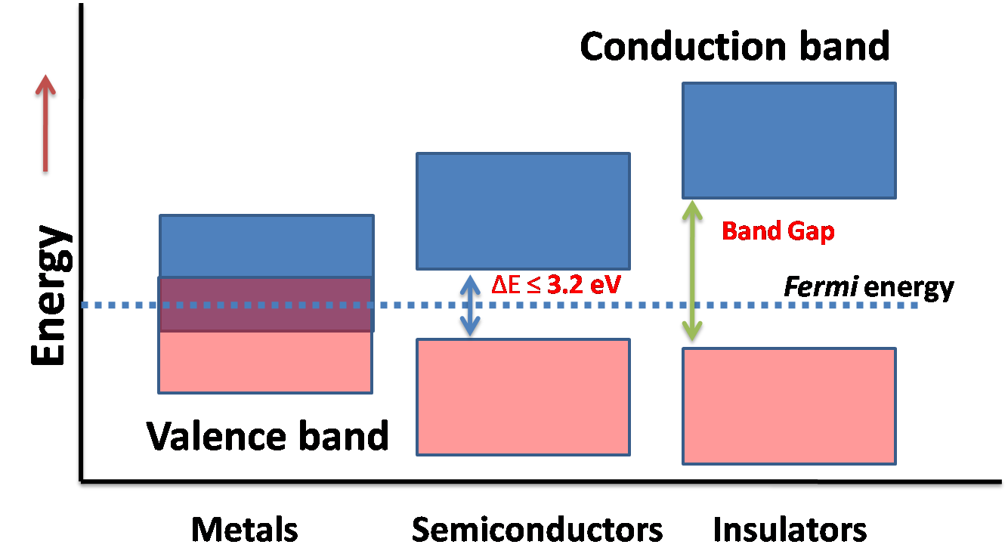
Energy band Diagram
Conduction in materials is due to free electrons present in conduction band
Once electrons jump from VB to CB they are free to conduct electricity..
In semiconductors application of small electric field gives free electrons enough energy
to jump from VB to CB and e- are ready to conduct electricity.
Notes:
Conduction band – electrons here are free from parent atom and are free to move through the material.. Small voltage when applied spurs the movement of elctrons known as drift to produce electrical current.
Insulators --- more than 10 ev
Semiconductor –below 3.2 ev..1.1 for si and 0.7 for germanium at 0K
Energy band diagrams show the energy levels of the electrons in the material. We are only interested in two of the bands, the conduction band and the valence band. The valence band is occupied by the electrons with the highest energy level of those which are still attached to their parent atoms, these are the outer most (or valence) electrons. The conduction band is occupied by electrons which are free from their parent atoms. These electrons are free to move through the material. (When a voltage is applied these electrons will drift to produce an electrical current.) In semiconductors there is an gap between the valence and conduction bands. This energy gap reflects the amount of energy that would be needed to remove an electron from it's parent atom (ie to transfer it from the valence to the conduction band).
In general ,we say that ferni level corresponds to that level which has probability 1/2 being occupied

Slide 6
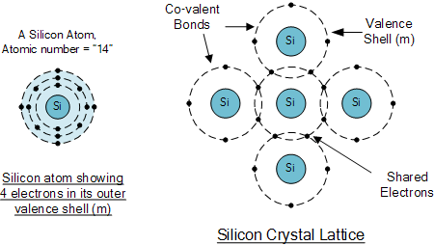
Semiconductor example..Silicon
Notes:
Semi-conductors have very few “free electrons” because their atoms are closely grouped together in a crystalline pattern called a “crystal lattice” but electrons are still able to flow, but only under special conditions.
To understand how semiconductors work, you must first understand a little about how electrons are organized in an atom. The electrons in an atom are organized in layers. These layers are called shells. The outermost shell is called the valence shell. The electrons in this shell are the ones that form bonds with neighboring atoms. Such bonds are called covalent bonds. Most conductors have just one electron in the valence shell. Semiconductors, on the other hand, typically have four electrons in their valence shell.
If all the neighboring atoms are of the same type, it’s possible for all the valence electrons to bind with valence electrons from other atoms. When that happens, the atoms arrange themselves into structures called crystals. Semiconductors are made out of such crystals, usually silicon crystals as shown in figure above(Silicon crystal Lattice).

Slide 7
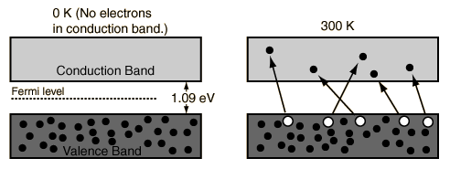
Semiconductor at room temp Does conduction occur ?
Notes:
At absolute zero (0K or -273K )temperature semiconductors act as insulators
Even in room temperature some e- may jump to CB to form free electrons.
When moving to CB they leave behind void at VB known as holes.
When applied to certain electric field these e- move towards +ve terminal while holes move towards –ve terminal.
Actually e- move while whole only appear to move .
Conduction is due to both e- and holes

Slide 8
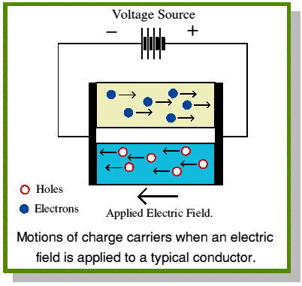
Application of electric field
Notes:
When applied to certain electric field these e- move towards +ve terminal while holes move towards –ve terminal.
Actually e- move while whole only appear to move .
Conduction is due to both e- and holes

Slide 9
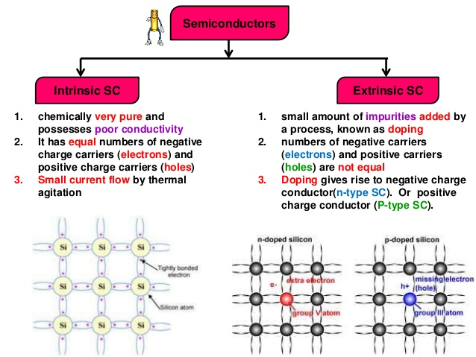
Intrinsic and Extrinsic semi-conductors
Antimony Arsenic Phosphorus --- (Pentavalent impurities)-group V---used to make N type extrinsic semiconductor
Alumunium indium and Boron ---(Trivalent impurities)—group III --used to make P type extrinsic semiconductor
Notes:
The ability of semiconductors to conduct electricity can be greatly improved by replacing or adding certain donor or acceptor atoms to this crystalline structure thereby, producing more free electrons than holes or vice versa. That is by adding a small percentage of another element to the base material, either silicon or germanium.
This process of adding donor or acceptor atoms to semiconductor atoms (the order of 1 impurity atom per 10 million (or more) atoms of the semiconductor) is called Doping
At room temperature intrinsic are poor conductors due to lack of mobile charges i.e. holes and electrons
But when doping is done they have enough mobile charges to conduct electricity.
Electronics is the flow of electrons in gas or vaccum or semiconductors
In the crystalline lattice structure of Si, the valence electrons of every Si atom are locked up in covalent bonds with the valence electrons of four neighboring Si atoms.
– In pure form, Si wafer does not contain any free charge carriers.
– An applied voltage across pure Si wafer does not yield electron flow through the wafer.
– A pure Si wafer is said to act as an insulator.
In order to make useful semiconductor devices, materials such as phosphorus (P) and boron (B) are added to Si to change Si’s conductivity.
Antimony Arsenic Phosphorus --- (Pentavalent impurities)-group V---used to make N type extrinsic semiconductor
Alumunium indium and Boron ---(Trivalent impurities)—group III --used to make P type extrinsic semiconductor

Slide 10
Effect of Temperature on Intrinsic semiconductor
Overall Conduction increases
Conductivity increases due to breakdown of covalent bond thus more electron hole pair are generated.In other words , the resistivity of the semiconductor have negative temperature coefficient.
Effect of light – conduction increases
Notes:
With a standard seminconductor increasing the temperature allows more electrons to enter the conduction band so it increases conductivity. However with an extrinsic seminconductor electrons still jump into the conduction band, however this effect is negligible relative to the reduction in conductivity caused by the lattice vibrating more. This is the same effect as when you have a normal conductor who's conductivity decreases with temperature. So the effect is a decrease in conductivity.
But with extrinsic semiconductors (whilst there are more electrons in the conduction band) there is a massive decrease in conductivity because when you heat it the lattice structure of the seminconductor vibrates more, so increases resistance. The increase in resistance is very big compared to the few extra electrons in the conduction band, the net effect is that the conductivity decreases. Another way of looking at is that in an extrinsic semiconductor you have the effects of a intrinsic seminconductor and a normal metallic conductor all in one. You have the extra electrons in the conduction band (like an instrinsic seminconductor) and you have the increase in resistance (like a normal conductor). The important factor is that the increase in resistance is very large relative to the effect of more electrons in the conduction band, so the net effect is the decrease in conductivity. Summary: Upon heating: Intrinsic: Increase conductivity due to extra electrons in conduction band. Extrinsic: Decrease conductivity due to increased resistance due to increase vibrations in the lattice/semiconductor.
In a semiconductor there is an ordered structure known as a lattice.
Where the dots are atoms and the lines are bond. It is a type of structure. "Latice: an arrangement of points or particles or objects in a regular periodic pattern in 2 or 3 dimensions" So having a vibrating lattice means basically that all of the atoms (which are structured) are vibrating more. The idea of atoms vibrating when they are heated is quite a simple idea I assume you have come across. So ye... the lattice vibrates, or the atoms vibrate which increases the probability that an electron will interact with it. The interaction between electrons and atoms in any conducting material is the cause of resistance. So more thermal energy -> atoms vibrate -> more interactions between electrons and atoms = more resistance. And I keep saying "atoms" whereas in reality they would be ions, but you know what I mean.

Slide 11
Effect of Temperature on extrinsic semiconductor
Overall Conduction decreases
Conductivity increases due to thermal agitation e- jump from VB to CB
The vibration of lattice increases thus making harder for free e-(n type) and free holes(p-type) to move . Thus increasing resistance.
Effect of B is predominant than A. Thus overall conductivity decreases with increase in temp for extrinsic semiconductor.
Notes:
With a standard seminconductor increasing the temperature allows more electrons to enter the conduction band so it increases conductivity. However with an extrinsic seminconductor electrons still jump into the conduction band, however this effect is negligible relative to the reduction in conductivity caused by the lattice vibrating more. This is the same effect as when you have a normal conductor who's conductivity decreases with temperature. So the effect is a decrease in conductivity.
But with extrinsic semiconductors (whilst there are more electrons in the conduction band) there is a massive decrease in conductivity because when you heat it the lattice structure of the seminconductor vibrates more, so increases resistance. The increase in resistance is very big compared to the few extra electrons in the conduction band, the net effect is that the conductivity decreases. Another way of looking at is that in an extrinsic semiconductor you have the effects of a intrinsic seminconductor and a normal metallic conductor all in one. You have the extra electrons in the conduction band (like an instrinsic seminconductor) and you have the increase in resistance (like a normal conductor). The important factor is that the increase in resistance is very large relative to the effect of more electrons in the conduction band, so the net effect is the decrease in conductivity. Summary: Upon heating: Intrinsic: Increase conductivity due to extra electrons in conduction band. Extrinsic: Decrease conductivity due to increased resistance due to increase vibrations in the lattice/semiconductor.
In a semiconductor there is an ordered structure known as a lattice.
Where the dots are atoms and the lines are bond. It is a type of structure. "Latice: an arrangement of points or particles or objects in a regular periodic pattern in 2 or 3 dimensions" So having a vibrating lattice means basically that all of the atoms (which are structured) are vibrating more. The idea of atoms vibrating when they are heated is quite a simple idea I assume you have come across. So ye... the lattice vibrates, or the atoms vibrate which increases the probability that an electron will interact with it. The interaction between electrons and atoms in any conducting material is the cause of resistance. So more thermal energy -> atoms vibrate -> more interactions between electrons and atoms = more resistance. And I keep saying "atoms" whereas in reality they would be ions, but you know what I mean.

Slide 12
What are P-type and N-type ?
Extrinsic Semiconductors are classified in to P-type and N-type semiconductor
P-type: A P-type material is one in which holes are majority carriers i.e. they are positively charged materials (++++)
N-type: A N-type material is one in which electrons are majority charge carriers i.e. they are negatively charged materials (-----)
Notes:
N-Type Silicon
Pentavalent impurities such as phosphorus, arsenic, antimony, and bismuth have 5 valence electrons.
When phosphorus impurity is added to Si, every phosphorus atom’s four valence electrons are locked up in covalent bond with valence electrons of four neighboring Si atoms. However, the 5th valence electron of phosphorus atom does not find a binding electron and thus remains free to float. When a voltage is applied across the silicon-phosphorus mixture, free electrons migrate toward the positive voltage end.
When phosphorus is added to Si to yield the above effect, we say that Si is doped with phosphorus. The resulting mixture is called N-type silicon (N: negative charge carrier silicon).
The pentavalent impurities are referred to as donor impurities.
P-Type Silicon —I
Trivalent impurities e.g., boron, aluminum, indium, and gallium have 3 valence electrons.
When boron is added to Si, every boron atom’s three valence electrons are locked up in covalent bond with valence electrons of three neighboring Si atoms. However, a vacant spot “hole” is created within the covalent bond between one boron atom and a neighboring Si atom. The holes are considered to be positive charge carriers. When a voltage is applied across the silicon-boron mixture, a hole moves toward the negative voltage end while a neighboring electron fills in its place.
When boron is added to Si to yield the above effect, we say that Si is doped with boron. The resulting mixture is called P-type silicon (P: positive charge carrier silicon).
The trivalent impurities are referred to as acceptor impurities.

Slide 13
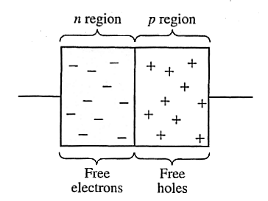
Diodes
Electronic devices created by bringing together a p-type and n-type region within the same semiconductor lattice. Used for rectifiers, LED etc
Notes:
A rectifier is an electrical device that converts alternating current (AC), which periodically reverses direction, to direct current (DC), which flows in only one direction. The process is known as rectification

Slide 14
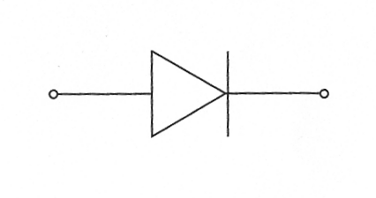
Diodes
It is represented by the following symbol, where the arrow indicates the direction of positive current flow.

Slide 15
Characteristics of Diode
Diode always conducts in one direction.
Diodes always conduct current when “Forward Biased” ( Zero resistance)
Diodes do not conduct when Reverse Biased
(Infinite resistance)
How ? Lets look at PN junction Theory to understand this

Slide 16
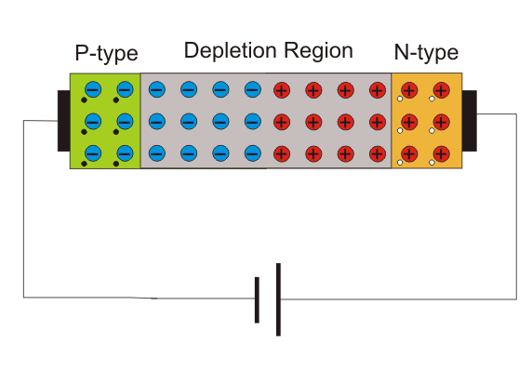
PN Junction Theory
Notes:
At P side…(trivalent –group III) beacuse it is void of elctron ..is ready to accept an electron..thus called the acceptor atoms...can be seen as –ve acceptor ion + a hole
At N side…(pentavalent –group V) beacuse it has extra elctron ..is ready to donate an electron..thus called the donor atoms...can be seen as +ve donor ion + an electron
Step 1 : Diffusion
Holes diffuse to right
electrons diffuse to left
Holes move to right and recombine with electrons
Electrons move to left and recombine holes
At the junction what is left on P side ---- negative acceptor ion
At the junction what is left on N side ----- positive donor ion
At junction no more holes and electrons (mobile charge carriers) are present..i.e. this region is void or depleted of charge carriers..thus called depletion region or transition region
Depletion region is void of charges so called depletion region
Width I micron (um)
Step 2 : creation of barrier potential
What is left on P side and N side is –ve acceptor ion and +ve donor ion respectively
This creates an electric field in direction of N type to P type
There potential difference is created then no more carriers(mobile charges i.e. either electrons or holes) can diffuse.
The barrier potential is 0.7 V for silicon and 0.3 for germanium

Slide 17
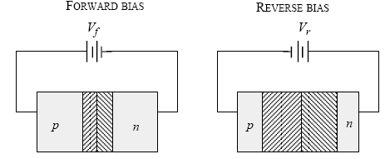
Forward Bias and Reverse Bias
Forward Bias : Connect positive of the Diode to positive of supply…negative of Diode to negative of supply
Reverse Bias: Connect positive of the Diode to negative of supply…negative of diode to positive of supply.

Slide 18
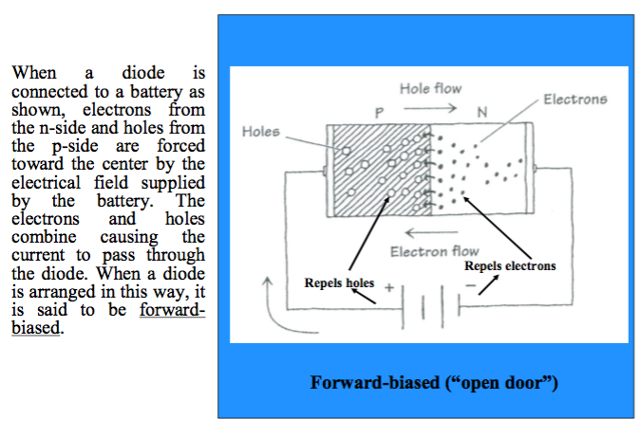
Forward Bias
Notes:
At forward bias condition
Holes from P side move towards junction
Electrons from N side also move towards junction
When forward Voltage is higher than barrier potential, the depletion region and barrier potential disappears.
So electrons and holes are free to move . Thus large current flows through the external circuit.
See VI characterstics of Diode
Diffusion current is a current in a semiconductor caused by the diffusion of charge carriers (holes and/or electrons). The drift current, by contrast, is due to the motion of charge carriers due to the force exerted on them by an electric field.
Breakpoint is not at the origin
Vr = offset or threshold voltage/ knee voltage
V<Vr →no current flows
V > Vr → current starts to flow --- current is only limited by resistance of semiconductor (bar p-n) and resistance of ohmic contacts….and current voltage relationship becomes approximately linear.(st line)

Slide 19
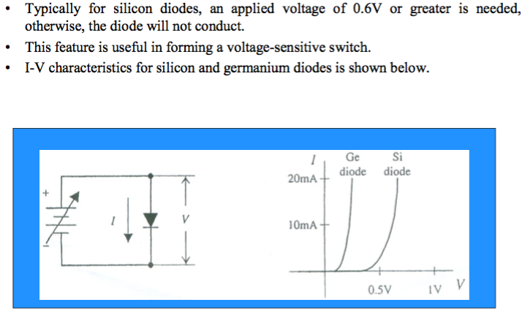
Forward Bias and IV characterstics
Notes:
At 0.6 for si and 0.3 V for germanium ,the barrier potential is overcome and current flows through the circuit.
This voltage is called Threshold voltage.
After threshold voltage the Current and Voltage is linearly related.

Slide 20
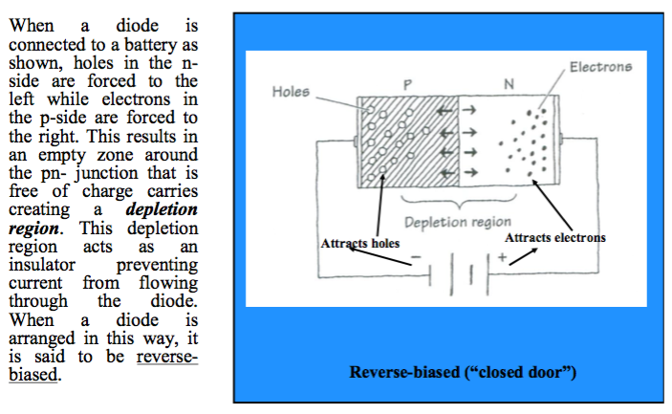
Reverse Bias
Notes:
For Reverse Bias
Ideally no current flows in Reverse bias ..But due to thermal agitation there are some electrons created in P region and some holes in N region which are called minority carriers. The barrier potential does not offer barrier for them unlike for majority charge carriers. These minority carriers wander over to junction and move towards majority carriers side giving rise to small reverse current known as reverse saturation current.
The magnitude of reverse current depends on junction temperature as minority carriers are simply thermally broken covalent bonds to create electrons and holes.

Slide 21
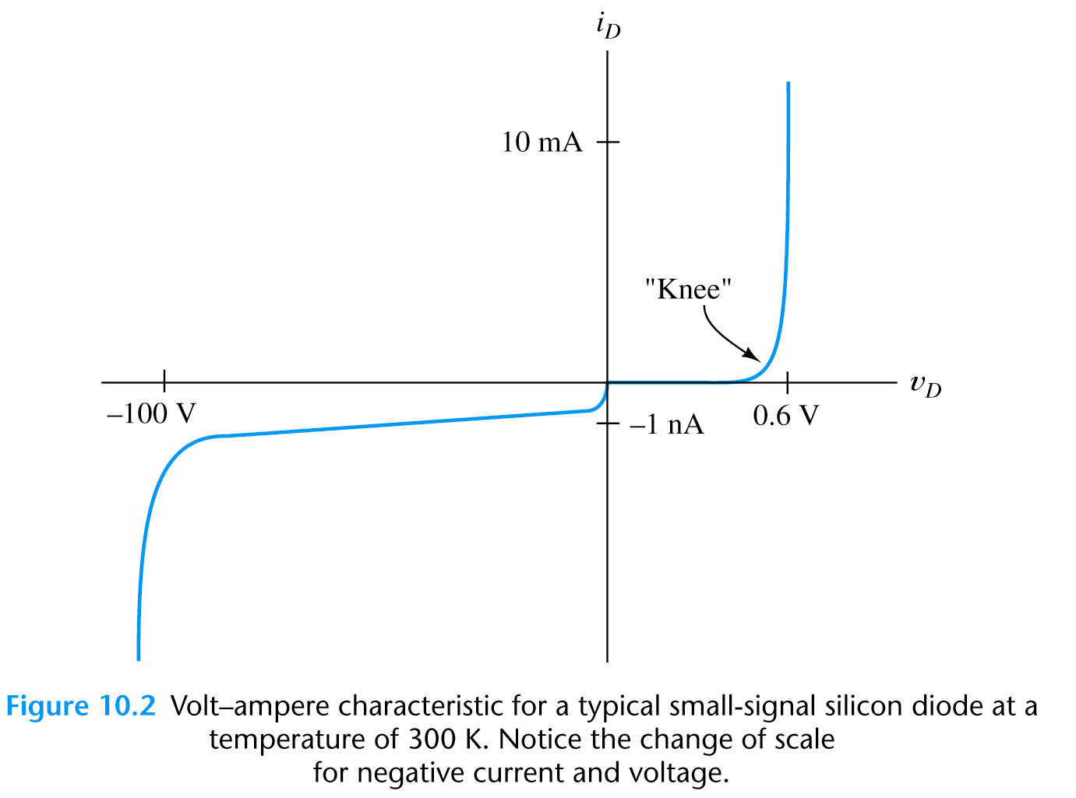
I-V Characteristics of a Diode
(Non Linear Device)
Notes:
For Forward Bias
When the diode is f.b. its depletion region and barrier potential reduce. As a result significant current flows even before breakdown voltage (around 0.5 for Si )
Large current flows when breakdown voltage or knee voltage(Vr) is reached.(Si – 0.7 , Ge – 0.3)
current is only limited by resistance of semiconductor (bar p-n) and resistance of ohmic contacts….and current voltage relationship becomes approximately linear.(st line).
If Vf is increased beyond certain limit, extremely large current flows and diode may be damaged.
Vf<Vr →no current flows
Vf > Vr → current starts to flow ---
For Reverse Bias
Ideally no current flows in Reverse bias ..But due to thermal agitation there are some electrons created in P region and some holes in N region which are called minority carriers. The barrier potential does not offer barrier for them unlike for majority charge carriers. These minority carriers wander over to junction and move towards majority carriers side giving rise to small reverse current known as reverse saturation current or leakage saturation current.
The magnitude of reverse current depends on junction temperature as minority carriers are simply thermally broken covalent bonds to create electrons and holes. The leakage saturation current doubles for every 10C rise in temperature.

Slide 22
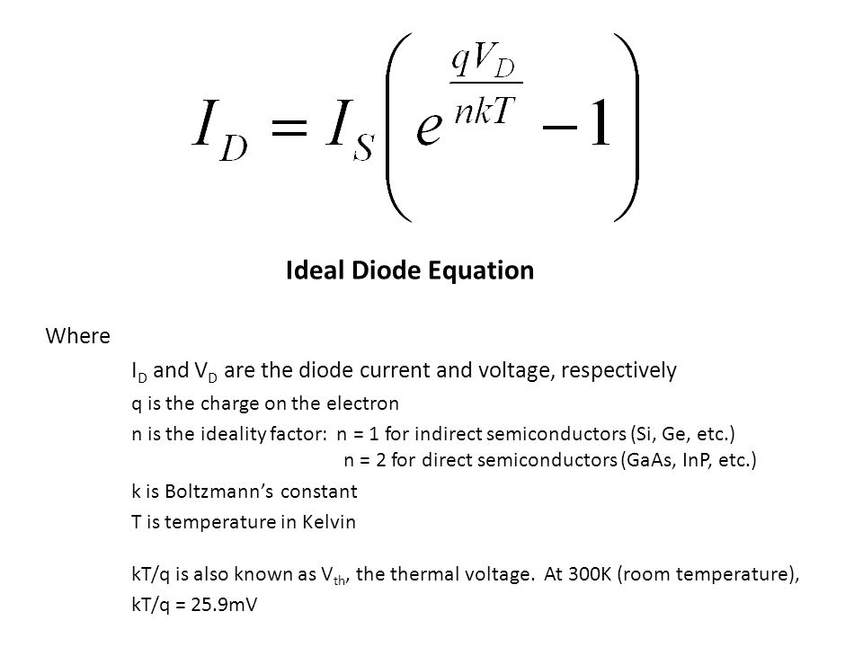
Shockley Diode law
Notes:
intrinsic ratio n = 2 for silicon
n = 1 for Ge
K = 1.38 * 10 ^ -23 J/K
Charge q = 1.6 * 10 ^ -19 C
Is = saturation current (reverse voltage applied)
Numerical pg 17 – 1.1 & 1.3

Slide 23
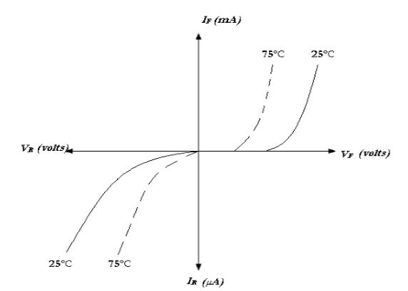
Effect of temperature on I-V
characteristics curve
Notes:
Pg 16
Numerical pg 18 – 1.2 & 1.5

Slide 24
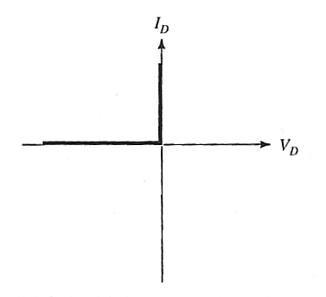
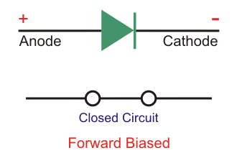
I-V characteristics of Ideal diode
Notes:
Ideally diode should conduct electricity as soon as forward bias Is applied . i.e zero resistance ( perfect conductor)
And should not conduct electricity when reverse bias is applied. (perfect insulator)
The ideal diode acts as a switch. (closed switch)
In practice no diode act as perfect switch.

Slide 25
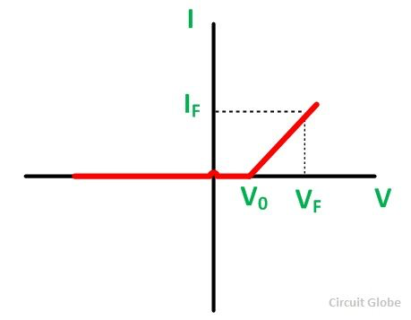
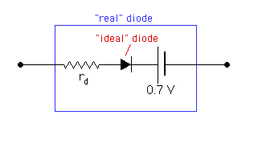
Real diode
Notes:
An actual diode neither behaves as a perfect conductor when f.b. nor act as a perfect insulator when r.b.
When f.b. – will not conduct until potential barrier Vo at the junction is overcome (0.7 for Si and 0.3 for Ge)
When applied voltage exceeds potential barrier, the diode starts conducting and small voltage drops across the internal resistance (forward resistance--rd) of the diode.
In actual practice current flows even before 0.7 V (for Si) as shown previously in I-V characteristics of diode.

Slide 26
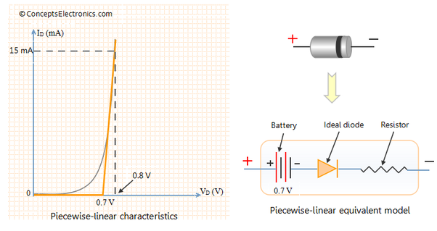
Piece wise Linear model of a diode
Notes:
In figure --- 0.7 V --- Vf & resistance -- Rf
Piece wise Linear model of a diode(numerical pg 19 example 1.4)
In electronics, diode modelling refers to the mathematical models used to approximate the actual behaviour of real diodes to enable calculations and circuit analysis. A diode's I-V curve is nonlinear (it is well described by the Shockley diode law). This nonlinearity complicates calculations in circuits involving diodes so simpler models are often required. Like the one shown above which shows IV characterstic as linear.
See notes pg 25..add on

Slide 27
Avalanche Breakdown
Notes:
Avalanche effect(Avalanche Breakdown)
When reverse bias is large enough ..the electrons on N side move with high velocity which collide with other atoms of Semiconductor. On doing so they break covalent bond and create electron hole pairs. Which then again gains velocity and dislodges other atoms. This effect is cumulative in nature and repeats itseld. This effect creates avalanche of free electrons thus called avalanche efect.This leads to breakdown of junction , thus a large amount of reverse current flows at the same reverse voltage . The voltage at which this occurs is called reverse bias voltage Vr.
(Zener Breakdown)

Slide 28
Zener Breakdown
Application of zenerbreakdown is zener diode
Voltage remains constant even if current changes
Thus can be used as voltage regulator
Numerical and explanation
Next class
Notes:
When reverse bias voltage is sufficiently high at junction, it may exert a strong force on bound electrons to tear them apart from covalent bond. Thus large amount of electron hole pair is generated through the rupture of
Covalent bond. This results in large reverse current to at the breakdown voltage.
Avalanche breakdown
-- occurs due to electrons gaining kinetic energy due to large reverse voltage (electric field)..and fast moving electrons disloging othe atoms.
-occurs at higher breakdown voltage than zener breakdown
Zener Breakdown
--occurs because of rupture of bound electrons from covalent bond.
---occurs at lower breakdown voltage than avalanche breakdown

Slide 29
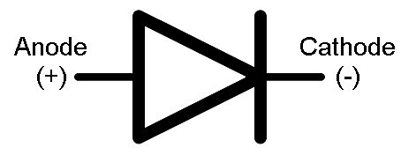
Rectification
Converting ac to dc is accomplished by the process of rectification.
Two processes are used:
Half-wave rectification;
Full-wave rectification.
Diode (PN junction) as a rectifier
Notes:
A rectifier is an electrical device that converts alternating current (AC), which periodically reverses direction, to direct current (DC), which flows in only one direction. The process is known as rectification.
Physically, rectifiers take a number of forms, including vacuum tube diodes, mercury-arc valves, copper and selenium oxide rectifiers, semiconductor diodes, silicon-controlled rectifiers and other silicon-based semiconductor switches.
Because of the alternating nature of the input AC sine wave, the process of rectification alone produces a DC current that, though unidirectional, consists of pulses of current. Many applications of rectifiers, such as power supplies for radio, television and computer equipment, require a steady constant DC current (as would be produced by a battery). In these applications the output of the rectifier is smoothed by an electronic filter (usually a capacitor) to produce a steady current.
More complex circuitry that performs the opposite function, converting DC to AC, is called an inverter.
Application
1.The primary application of rectifiers is to derive DC power from an AC supply (AC to DC converter). Virtually all electronic devices require DC, so rectifiers are used inside the power supplies of virtually all electronic equipment.
2.Converting DC power from one voltage to another is much more complicated. One method of DC-to-DC conversion first converts power to AC (using a device called an inverter), then uses a transformer to change the voltage, and finally rectifies power back to DC. A frequency of typically several tens of kilohertz is used, as this requires much smaller inductance than at lower frequencies and obviates the use of heavy, bulky, and expensive iron-cored units.
3.Rectifiers are also used for detection of amplitude modulated radio signals. The signal may be amplified before detection. If not, a very low voltage drop diode or a diode biased with a fixed voltage must be used. When using a rectifier for demodulation the capacitor and load resistance must be carefully matched: too low a capacitance makes the high frequency carrier pass to the output, and too high makes the capacitor just charge and stay charged.
4.Rectifiers supply polarised voltage for welding. In such circuits control of the output current is required; this is sometimes achieved by replacing some of the diodes in a bridge rectifier with thyristors, effectively diodes whose voltage output can be regulated by switching on and off with phase fired controllers.

Slide 30
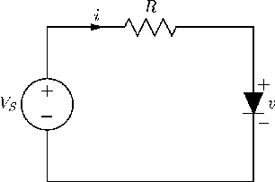
Diode Circuits

Slide 31
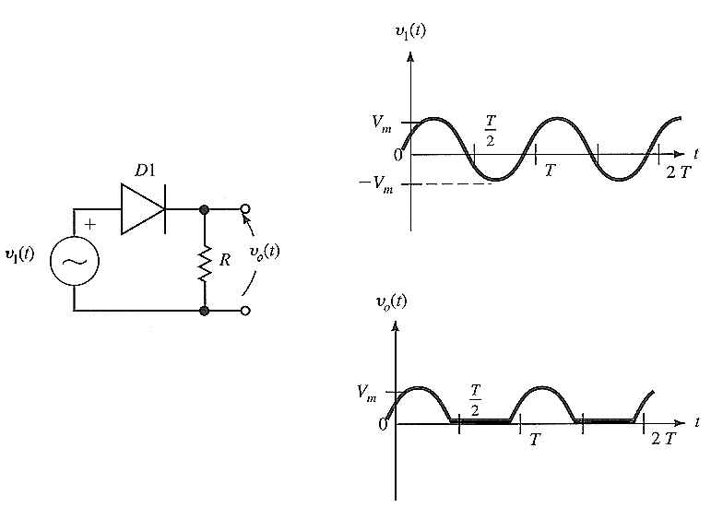
Half-wave Rectification
Simplest process used to convert ac to dc.
A diode is used to clip the input signal excursions of one polarity to zero.
Notes:
In half-wave rectification of a single-phase supply, either the positive or negative half of the AC wave is passed, while the other half is blocked.
Because only one half of the input waveform reaches the output, mean voltage is lower.
Half-wave rectification requires a single diode in a single-phase supply, or three in a three-phase supply.
Circuit Details
Single crystal diode acts as a half wave rectifier
The ac to be rectified is applied in series with diode and load resistance R
Generally ac supply is given through transformer --- two advantages ---1.allows us to stepup or step down ac voltage.2. transformer isolates the rectifier circuit from power line thus reduces risk of electric shock
Operation
Ac changes its polarity every half cycle.
During +ve cycle diode is f.b. and diode conducts current
During -ve cycle diode is r.b. and diode does not conduct current
Since current flows in only one half ..the current always flows in only one direction..thus called unidirectional
Rectifiers yield a unidirectional but pulsating direct current.
Pulsating dc means contains both ac and dc component(also known as ripple). The ac component is undesired and must be kept away from the load. To do so filter circuits are used which removes the ac component and allows only dc component to reach load.
These pulsating dc are smoothed using filter circuits.
Wave form
The input and output frequency is same. i.e. when input completes one cycle output also completes one cycle
Disadvantages
1.The pulsating dc has ac component whose frequency is same as supply ac. Thus elaborate filtering systems are needed
OR
half-wave rectifiers produce far more ripple than full-wave rectifiers, and much more filtering is needed to eliminate harmonics of the AC frequency from the output.
The ac supply power only one half, thus output is low. (efficiency low)

Slide 32

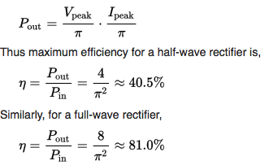
Efficiency of Half wave Rectifier
Notes:
Half-wave rectifier
Rectifier efficiency is defined as ratio of dc output power to the ac input power.
Power = I^2 * R
The no-load output DC voltage of an ideal half-wave rectifier for a sinusoidal input voltage is:
V r m s = V p e a k/2
V d c = V p e a k / π
where:
Vdc, Vav – the DC or average output voltage,
Vpeak, the peak value of the phase input voltages,
Vrms, the root-mean-square value of output voltage.
The RMS value is the effective value of a varying voltage or current. It is the equivalent steady DC (constant) value which gives the same effect. For example, a lamp connected to a 6V RMS AC supply will shine with the same brightness when connected to a steady 6V DC supply.

Slide 33
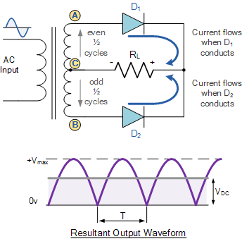
Full-wave rectification(Center Tap)
D1
D1
D2
D2
Notes:
Circuit
The circuit consists of two diodes D1 and D2 as shown above. The full wave rectifier circuit consists of two power diodes connected to a single load resistance (RL) . A centre tapped secondary winding AB is connected with these diodes such that each diode uses one half of ac supply to provide current to the load.
Operation
When point A of the transformer is positive with respect to point C, diode D1 conducts in the forward direction as indicated by the arrows.
When point B is positive (in the negative half of the cycle) with respect to point C, diode D2 conducts in the forward direction
and the current flowing through resistor R is in the same direction for both half-cycles.
Thus dc is obtained across the load R
As the output voltage across the resistor R is the phasor sum of the two waveforms combined, this type of full wave rectifier circuit is also known as a “bi-phase” circuit.
As the spaces between each half-wave developed by each diode is now being filled in by the other diode the average DC output voltage across the load resistor is now double that of the single half-wave rectifier circuit.
Waveform
Disadvantages
1.The main disadvantage of this type of full wave rectifier circuit is that a larger transformer for a given power output is required with two separate but identical secondary windings making this type of full wave rectifying circuit costly compared to the “Full Wave Bridge Rectifier” circuit equivalent.
2.Difficult to locate center tap on secondary winding
3.Dc output is small as each diode uses only half of the transformer secondary voltage
4. The didde must have high Peak Inverse Voltage
Peak Inverse Voltage for center tap
During first phase when diode D1 is conductiong while D2 is not conducting. The whole of the secondary voltage appears across the non conducting diode.
Consequently the peak inverse voltage is twice the maximum voltage across half-secondary winding i.e.
PIV = Vm * 2

Slide 34
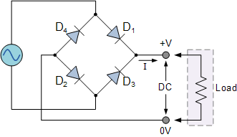
Full Wave Rectificaation (bridge)
P
Q
Notes:
Circuit
Another type of circuit that produces the same output waveform as the full wave rectifier circuit above, is that of the Full Wave Bridge Rectifier. This type of single phase rectifier uses four individual rectifying diodes connected in a closed loop “bridge” configuration to produce the desired output. The main advantage of this bridge circuit is that it does not require a special centre tapped transformer, thereby reducing its size and cost. The single secondary winding is connected to one side of the diode bridge network and the load to the other side as shown
The four diodes labelled D1 to D4 are arranged in “series pairs” with only two diodes conducting current during each half cycle.
Operation
The Positive Half-cycle
During the positive half cycle of the supply, diodes D1 and D2 conduct in series while diodes D3 and D4 are reverse biased and the current flows through the load as shown below.
The Negative Half-cycle
During the negative half cycle of the supply, diodes D3 and D4 conduct in series, but diodes D1 and D2 switch “OFF” as they are now reverse biased. The current flowing through the load is the same direction as before.
Advantages
The need of center tapped transformer is eliminated
The output is twice that of centre tap circuit. (because input is taken half of the secondary winding in centre tap)
The PIV is one half that of centre tap circuit
Disadvantages
It requires four diodes instead of two
PIV
The peak Inverse voltage of each diode is equal to the maximum secondary voltage of transformer.
Suppose during +ve cycle of input ac P is +ve and Q is –ve. Under such condition diode D1 and D2 are forward biased while diodes D3 and D4 are reverse biased
D1 and D2 are fb and can be assumed to be wire with some resistance.
D3 and D4 are parallel to the secondary winding of transformer. Thus PIV is equal to maximum voltage across secondary winding which is equal to Vm
In another cycle the process is same and PIV for D1 and D2 is also equal to Vm.
Thus PIV = Vm (bridge rectifier)

Slide 35
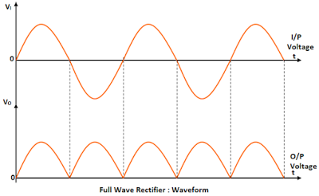
Full wave bridge rectifier waveform
D1D2
D3D4
D1D2
D3D4
Notes:
Waveform
The output frequency of full wave rectifier is double that of input frequency.
Bcoz while input completes one cycle output completes two cycle as shown in the waveform

Slide 36


Efficiency Full wave rectifier
Efficiency, h is the ratio of dc output power to ac input power
Notes:
Rectifier efficiency (η) is defined as the ratio of DC output power to the input power from the AC supply. Even with ideal rectifiers with no losses, the efficiency is less than 100% because some of the output power is AC power rather than DC which manifests as ripple superimposed on the DC waveform. For a half-wave rectifier efficiency is very poor,

Slide 37






Ripple Factor
The ripple factor for a Full Wave Rectifier is given by
Notes:
The ratio of rms value of ac component to the dc component in the rectifier output is known as ripple factor.
The RMS value is the effective value of a varying voltage or current. It is the equivalent steady DC (constant) value which gives the same effect. For example, a lamp connected to a 6V RMS AC supply will shine with the same brightness when connected to a steady 6V DC supply.
Ripple factor = Iac/Idc
Therefore ripple factor is very important term in deciding the effectiveness of a rectifier.
Smaller ripple factor means less effective ac component i.e more effective is the rectifier

Slide 38
Adv and dis adv of center tap and bridge rectifier
Disadv of center tap
It is difficult to locate the center tap on the secondary winding
The dc o/p is small as each diode utilises only one half of the transformer secondary voltage
The diode used must have high peak inverse voltage
Adv of bridge
No need for center tapped transformer
o/p is twice that of the centre tap for the same secondary voltage
PIV is half of the center tap
i.e PIV = Vm
DIS adv
Need of 4 diodes
Notes:
PIV for center tap
During first phase when diode D1 is conductiong while D2 is not conducting. The whole of the secondary voltage appears across the non conducting diode.
Consequently the peak inverse voltage is twice the maximum voltage across half-secondary winding i.e.
PIV = 2 * Vm

Slide 39
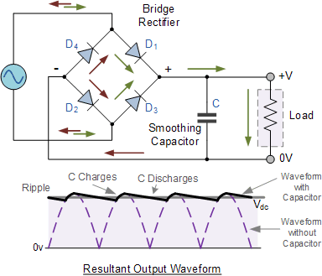

Smooting Capacitor
Notes:
Rectifiers yield a unidirectional but pulsating direct current.
Pulsating dc means contains both ac and dc component. The ac component is undesired and must be kept away from the load. To do so filter circuits are used which removes the ac component and allows only dc component to reach load.
The Smoothing Capacitor
We saw in the previous section that the single phase half-wave rectifier produces an output wave every half cycle and that it was not practical to use this type of circuit to produce a steady DC supply. The full-wave bridge rectifier however, gives us a greater mean DC value (0.637 Vmax) with less superimposed ripple while the output waveform is twice that of the frequency of the input supply frequency. We can therefore increase its average DC output level even higher by connecting a suitable smoothing capacitor across the output of the bridge circuit as shown
The smoothing capacitor converts the full-wave rippled output of the rectifier into a smooth DC output voltage. Generally for DC power supply circuits the smoothing capacitor is an Aluminium Electrolytic type that has a capacitance value of 100uF or more with repeated DC voltage pulses from the rectifier charging up the capacitor to peak voltage.
However, their are two important parameters to consider when choosing a suitable smoothing capacitor and these are its Working Voltage, which must be higher than the no-load output value of the rectifier and its Capacitance Value, which determines the amount of ripple that will appear superimposed on top of the DC voltage.
Too low a capacitance value and the capacitor has little effect on the output waveform. But if the smoothing capacitor is sufficiently large enough (parallel capacitors can be used) and the load current is not too large, the output voltage will be almost as smooth as pure DC. As a general rule of thumb, we are looking to have a ripple voltage of less than 100mV peak to peak.
The maximum ripple voltage present for a Full Wave Rectifier circuit is not only determined by the value of the smoothing capacitor but by the frequency and load current, and is calculated as
Bridge Rectifier Ripple Voltage
Where: I is the DC load current in amps, ƒ is the frequency of the ripple or twice the input frequency in Hertz, and C is the capacitance in Farads.
The main advantages of a full-wave bridge rectifier is that it has a smaller AC ripple value for a given load and a smaller reservoir or smoothing capacitor than an equivalent half-wave rectifier. Therefore, the fundamental frequency of the ripple voltage is twice that of the AC supply frequency (100Hz) where for the half-wave rectifier it is exactly equal to the supply frequency (50Hz).
The amount of ripple voltage that is superimposed on top of the DC supply voltage by the diodes can be virtually eliminated by adding a much improved π-filter (pi-filter) to the output terminals of the bridge rectifier. This type of low-pass filter consists of two smoothing capacitors, usually of the same value and a choke or inductance across them to introduce a high impedance path to the alternating ripple component
Another more practical and cheaper alternative is to use an off the shelf 3-terminal voltage regulator IC, such as a LM78xx (where “xx” stands for the output voltage rating) for a positive output voltage or its inverse equivalent the LM79xx for a negative output voltage which can reduce the ripple by more than 70dB (Datasheet) while delivering a constant output current of over 1 amp.

Slide 40
Filtering Circuits
Capacitor filter
LC filter
Pi filter

Slide 41
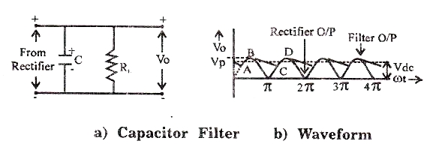
Shunt Capacitor Filter

Slide 42
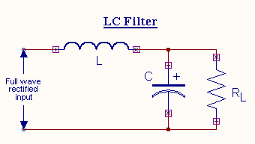
LC Filter (Choke Input Filter)

Slide 43
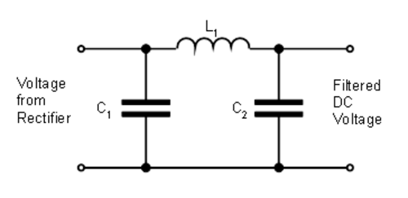
PI Filter

Slide 44
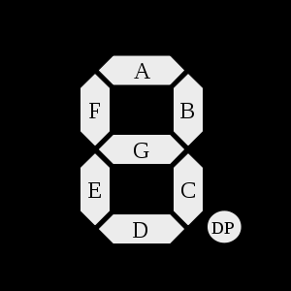
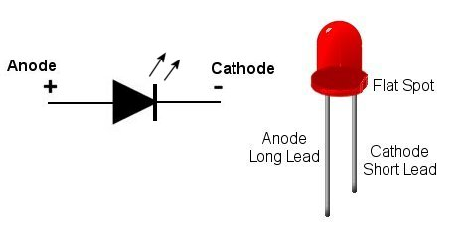
Application of LED
7 segment Display
Power indicator

Slide 45
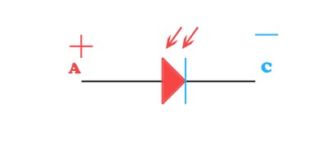
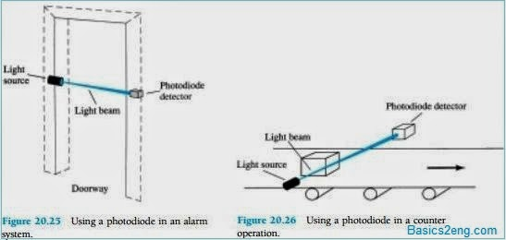
Application of photodiode
Alarm system
Counter circuit

